Slide 1


OBI & Current Positioning July 2019
Completed 05/07/2019

Slide 2
Contents
Defining the Cycle
Economic Data
Asset allocation
Currency Risk due to positive Brexit outcome
US / China Trade Deal Risks
US Fed Rate Movement Risks
The Risk of Lower Corporate Earnings
Data Sets
Legals

Slide 3
Defining the cycle

Slide 4
July 2019
Defining Cycles
Asset Managers and Investors are faced with a complex combination of time horizons & risks
Page 1

Slide 5
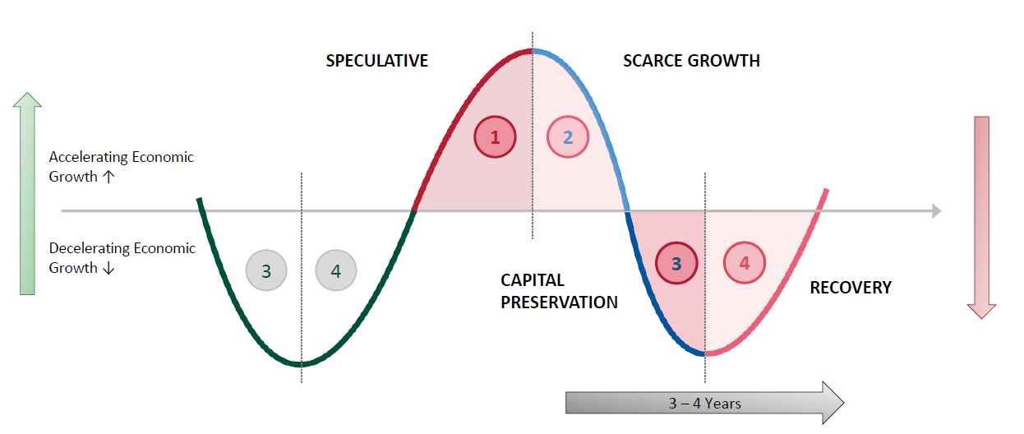
July 2019
How do we quantify the cycle and where are we now?
The cycle can be broken down into 4 distinct phases
Oct 2017
Q4 2018 - Q3 2019
Economic data now suggests that the cycle is in stage 3, therefore equity markets are expected to decline to reflect decelerating economic growth, before rallying on the recovery as we go into stage 4. Markets start to turn positive in 4 and highest % gains are achieved in 4 and 1.
Page 2

Slide 6
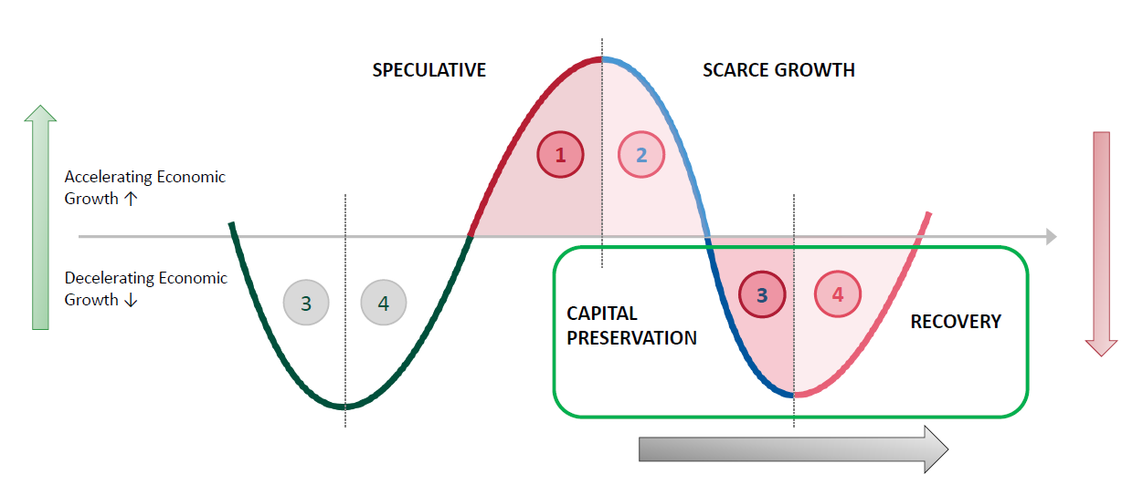
July 2019
A recovery follows the “Capital Preservation” phase
The cycle can be broken into four distinct phases
Next Step
Q 3 / Q4 2019 - ?
The % annual returns are highest in the recovery & speculative phases due to markets overselling before reconnecting with the optimism of a new cycle and valuations being at their lowest. We have not seen the worst of it yet which is why we expect markets to fall again once earnings start to come through from the 15th of this month.
Page 3

Slide 7
Economic Data

Slide 8
July 2019
What are we watching and when do we expect returns to become positive?
Asset Allocation Strategy focus based on Analysis start of July 2019
The summary of data in the Macro pack is that global growth is slowing, with key economies showing signs of economic weakness going into the second half of the year. What we are now seeing is increasingly negative economic data, combined with the spreading of risk-off sentiment in financial markets, evidenced by the sharp reduction in yields in bond markets and significant inflows into safe haven assets in recent weeks. At the same time, equity markets have rallied in the absence of supportive economic data, primarily due to a lack of alternative places to put investment capital. The disconnect between the economic data and equity markets is extremely concerning, with economists becoming increasingly bearish as time goes on.
If the markets as a whole were circa 10% lower than they are today and we had resolved our Brexit issue over sterling, it is likely that we would be removing the shorts positions and allocating to equities in the US and likely mid-caps in the UK. We would not reallocate aggressively however because the data remains inconsistent, and we would need to see evidence of an improvement in economic conditions. As it stands, the economic data and the emerging trends are becoming increasingly similar to the data we had in 2008 as we find ourselves at the end of the economic cycle.
Overall, equity markets appear to be disregarding the economic data in favour of optimism over central bank intervention, and as I will not invest my own money, I will not invest our clients’ money into this market until we have evidence that the slowdown is temporary, the currency risks have abated, and equity valuations are more realistic. The fact that consumer confidence in the G4 is slowing in all areas but the US, combined with the spreading of negative economic sentiment across all regions and a significant slowdown in industrial production since Q4 last year suggests that we must look past the bright spots observed towards the end of Q1 and acknowledge the data that the global economy is weakening.
As a result, we still view the current situation in the global economy as one that causes confusion, with over inflated and unsupported valuations that has data that is good, bad, and ugly. On that basis, we will continue to maintain a defensive position. Our outlook therefore remains negative for equities until we have clarity of data and valuations that are not over inflated.
Page 4

Slide 9
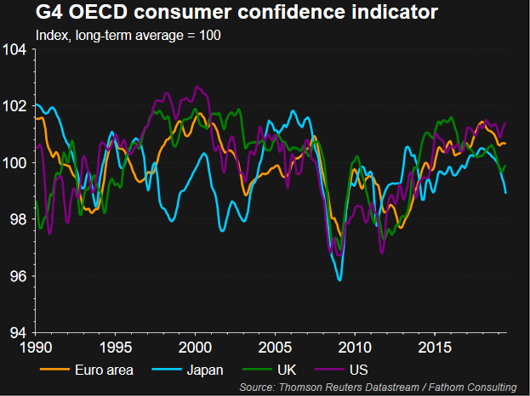
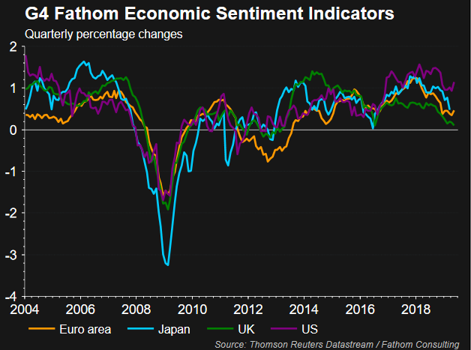
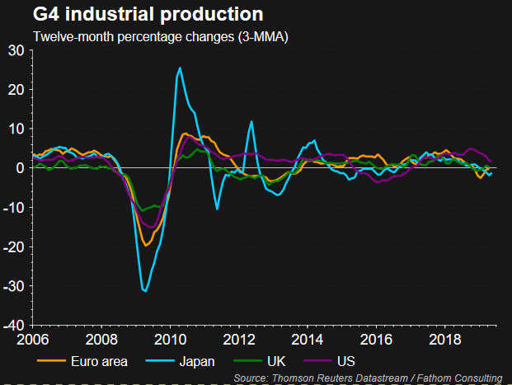
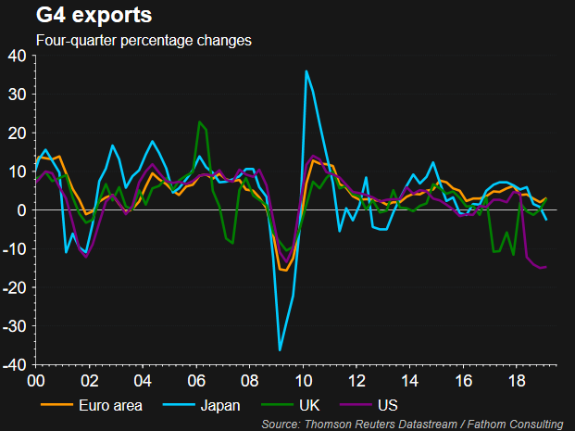
July 2019
G4 Data Summaries
Page 5

Slide 10
July 2019
What are we watching and when do we expect returns to become positive?
US
The US economy is showing signs of slowing momentum, with PMI survey data showing signs of near stagnation of operating conditions across the manufacturing sector. Business conditions according to the PMI survey are the toughest in a decade, and the past two months have seen the lowest PMI readings since 2009. The jobs market is beginning to show signs of weakness, however strong June labour market data could take a potential July interest rate cut off the table. The market is currently pricing in a July rate cut of 25 basis points as an ‘insurance cut’ to counteract economic weakness brought about by the recent escalation of US-China trade tensions. If the Fed did not cut in July, this could result in a selloff as optimism of a rate cut seems to be the only thing buoying US markets higher given the economic data.
Q2 Earnings season is expected to kick off in the next fortnight in the US, and investors will be watching company releases closely to ascertain expected performance for the rest of the year. Corporates will be hoping for some reprieve in the second half of the year following economic and political uncertainty, teamed with an escalation of tariffs, however hopes for a second half recovery in earnings has been abating in recent weeks. This has resulted in an alarming amount of downward revisions of earnings expectations for Q2 and for the second half of 2019. According to Factset data, the number of S&P 500 companies issuing negative earnings guidance is at the second highest number since 2006. As corporate earnings are what should be driving equity valuations, a significant decline in earnings in Q2 would likely result in a decline in equity markets to reflect a lower growth, weaker economic environment. Current earnings expectations do not justify equity prices at current levels, with the S&P 500 trading at a price multiple of 17x earnings. Given the current data, we retain the S&P 500 short and would sell in favour of US equities if S&P fell below 2650 and data supported re-entry.
Asia
If we look at the Chinese markets, services PMI has slipped to a four-month low and into contractionary territory, and business confidence remains at a record low. Despite efforts to introduce stimulus to the Chinese economy, the domestic economy is weakening and stimulus does not appear to be addressing the key issues. US-China trade tariffs have been impacting the Chinese economy and feeding into lower demand across the region. In Japan, the manufacturing PMI continues to fall as a result of the trade war impacting demand for auto parts, and production volumes have fallen for six consecutive months. In South Korea, manufacturing is at a four-month low as a result of the trade war and shifting supply chains. Trade powerhouse Singapore is also being affected, with the manufacturing sector posting the sharpest downturn in operating conditions since the data began.
From an investment perspective therefore, looking at China, and the negative impacts that lower demand are having on the region as a whole, we are concerned about the outlook and would not today allocate anything to the region. The fact that the region is again slowing, and consumer sentiment is falling cannot be supportive either for the outlook for the global economy. Today we remain unallocated.
Page 6

Slide 11
July 2019
What are we watching and when do we expect returns to become positive?
Eurozone
From an investment perspective, European equities are not that expensive relative to historical price levels, therefore looking at Europe based on the data, we would look to maintain our long / short active position with Odey as we are concerned about the outlook, noting there are some bright spots so using a manager that deploys both long and short strategies makes sense at this juncture. When you review the area, the economic data continues to indicate economic weakness across the bloc, with Germany now appearing to be the weakest country in economic terms. Austria, Spain, Ireland and Italy all have PMI readings steadily below 50, in contraction territory. Export orders have been falling across the board, and have been falling since President Trump’s initial spat with China in September. According to Markit, Europe’s downturn is showing no signs of ending, with forward looking indicators remaining worryingly subdued.
The Eurozone economy has already weakened significantly, however in the context of a slowing China and US, coupled with a further slowing UK, the risks of investing long into a market that looks relatively inexpensive on the surface are too high. We need to see more evidence that the global economy is okay before we make further investment into the Eurozone and if sterling has not strengthened, exposure needs to be GBP hedged. Today we retain Odey to maintain long / short strategy
UK
UK Equities remain uncertain as an asset class based on the outlook. In the UK, the data continues to deliver evidence of weak economic activity in Q2. Services PMI survey avoided the drop into contractionary territory indicated by the manufacturing and construction gauges, however a reading of 50.2 suggests that the UK economy is now stagnating. At the same time, PMI manufacturing index is at its lowest level since February 2013, with some sectors worse than others in anticipation for more Brexit chaos as the conservative leadership contest rumbles on ahead of the October Article 50 deadline. Based on past data, Q2’s surveys are consistent with the UK economy contracting by 0.1% over the quarter, however with retailers also performing relatively poorly, the contraction could be more like 0.2%, representing the first GDP contraction since Q4 2012.
As regards to the FTSE 100, we are still worried about the impact a deal on Brexit and improving outlook will have on the index due to a strengthening of sterling, and for that reason and based on valuations being higher than anticipated, we believe maintaining the FTSE 100 short position and removing it somewhere close to 6700 would be positive and ensure the position gave us a positive return. The continued lack of support for a no-deal Brexit has reduced the risk of a recession enough in our opinion to allow us to invest into different variants of direct UK property, however we continue to monitor the risks closely considering political developments. We still feel that UK equities are overvalued based on the outlook and lack of inward investment and uncertainty over Brexit.
Page 7

Slide 12
July 2019
What are we watching and when do we expect returns to become positive?
Overall
It is clear that risks towards the downside are increasing within the global economy, and therefore investors must choose exposure carefully, exercising caution when investing into equity markets. Given the risks and considering the risk-return trade-off, we retain a very low exposure to traditional equity markets, with exposure coming instead from multi-asset funds and our long/short European holding. When we look at each region, considering current equity valuation levels, the data remains supportive of a sell off in US and UK markets, therefore by retaining the two shorts, we remain well positioned to benefit from this. Given the data and with Q2 US corporate earnings still to come, it is our view that this is likely to happen within this quarter.
Regarding Brexit, if the UK were to stay in the EU, or remain closely aligned, then there is no doubt that FTSE 250 and all share assets would appreciate on the back of investment optimism and the hope that the chancellor would unlock his war chest and invest heavily in the UK and increase public spending to boost the economy. This will have less of an impact on the FTSE 100 as these companies get about 70% of their income from overseas and would therefore potentially lose out if we stayed in the Eurozone in any way due to the strengthening impact on overseas earnings if sterling rises to forecasted rates as detailed below.
It is therefore our view that the delays caused by Brexit allow the current economic situation to become clearer globally so that we can deploy assets into Mid-Cap and Small-Cap UK Equity and benefit from that upturn. Either way, if there was a positive outlook and Brexit outcome that was seen as significantly positive for the UK, it is likely that we would deploy a tactical trade into Mid-cap stocks but not yet. Based on the near-term destocking and slower than expected growth in China, we do not think the near-term outlook for UK mid cap and small cap is positive from levels seen today. Similar to US equities, if we saw a 10% pull back, we may consider allocating again.
When you review, along similar lines to the previous regional analysis, everything reflects that the momentum is fading. There is no doubt that some bright spots still exist, such as seen in US and European labour markets (which tend to lag behind the economic data), however all other indicators are fading and we need to see more evidence of an improvement in the global economy before we make further investment into equities and have some form of Brexit outcome before we invest in unhedged global exposure.
Today we retain the FTSE 100 short, sell if FTSE falls below 6700 and go long if data justifies, and continue to see benefit in hedging global exposure back to sterling where possible. We will allocate to UK Mid Caps and some Small caps if we have a positive Brexit outcome as a tactical investment.
Page 8

Slide 13
Asset Allocation

Slide 14
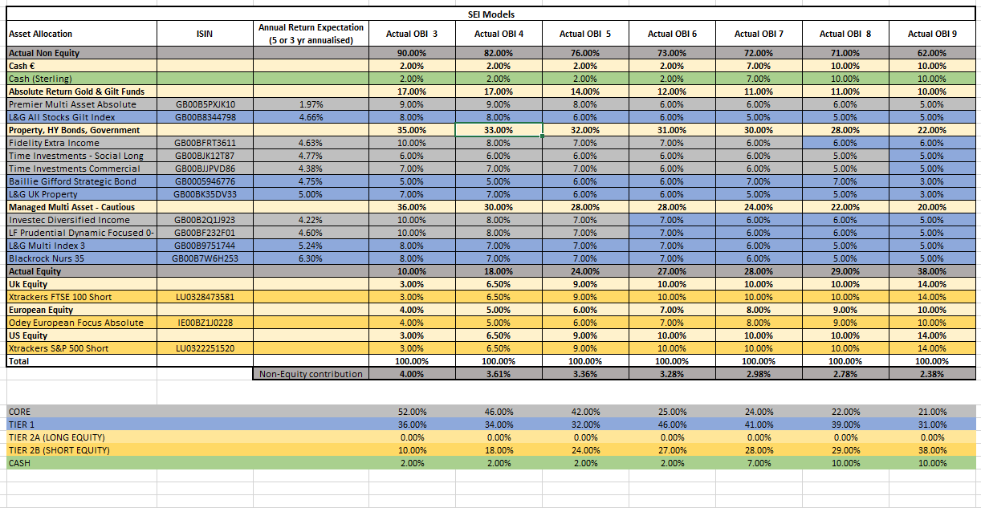
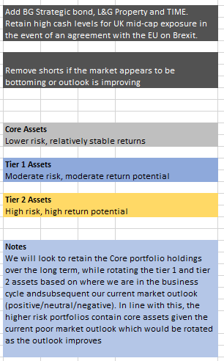
July 2019
Asset Allocation in Models from May 2019
Page 9

Slide 15
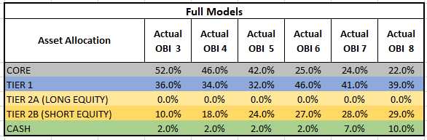
July 2019
Core Verses Tier 1 and Tier 2 – Explanation of Strategy
Within the portfolio construction you will see the terms Core, Tier 1 and Tier 2 in reference to our asset allocations. These categories were introduced to ensure that we have less stock turnover and more stable and long term investment constituents in the lower risk portfolios and more active management in the higher risk portfolios.
When in capital preservation or defensive mode, there will not be a great deal of difference between OBI Active 3 and Active 8 as regards to the assets held but as return potential increases, the Tier 1 and Tier 2 assets will be rotated to invest again in risk assets that give greater return potential.
As we are currently in capital preservation mode, we hold assets across all portfolios that will form the core of Active 3, however for example these are classified as Tier 1 in Active 7 or 8 as they will be removed in favour of riskier assets when the Value at Risk (VAR) analysis and data tells us that the risk is worth being taken. As it stands, the breakdown by each tier is shown below:
Please note some of the cash in the higher risk portfolios is held so that we can immediately buy Mid Cap and Small Cap UK Equity assets if we have a positive Brexit.
Page 10

Slide 16
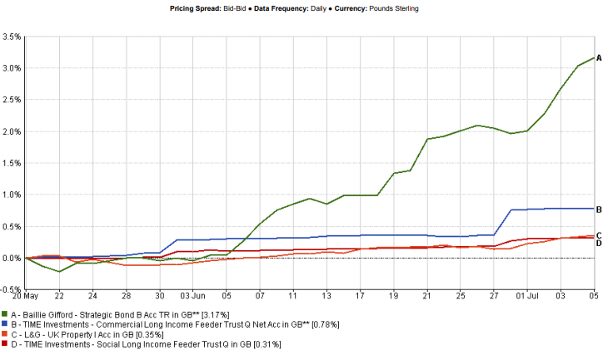
July 2019
Performance of the assets added in May
In May, we redeployed excess cash into assets that will generate returns with very low levels of expected volatility to add to the return profile whilst remaining defensive. Where a holding is defined as a core holding it will be retained. Where identified as Tier 1 holding, it will be rotated out when risk abates and as the value of investing in equities returns.
Investments added
Time Investment Social Long Fund (Core Holding)
Time investments Commercial Fund (Core Holding)
Baillie Gifford Strategic Bond Fund (Tier 1 Holding)
L&G UK Property Fund (Tier 1 Holding)
Page 11

Slide 17
July 2019
We maintained all other positions and the reasons for introducing each of the new positions were:-
1. TIME Investments Social Long Income Fund
TIME is a well-established manager of freehold property, and is a stand out performer in the UK direct property space, focusing on securing long term leases in high quality investments in sectors with favourable supply and demand fundamentals over the long term. The fund added 0.31% to portfolios from 20th May (when it was added) to the 5th July. The fund aims to deliver income of 4.5% per annum regardless of market conditions and is performing in line with our expectations.
This fund invests in social infrastructure assets across the UK to provide stable investment returns via income and capital appreciation. It does so by investing in freehold property such as nurseries, GP practices, care homes and social assisted living. Although it falls under the traditional direct property investment space, the fund derives its returns predominantly from the rental yields on its property, rather than from capital appreciation. As such, it provides relatively stable returns over the long term at a lower level of risk than traditional property funds, and will be a key core holding to our portfolios going forward. As property exposure comes from the social sector, its leases are typically held by government-backed agencies, therefore the rental counterparty risk typically associated with this sector is mitigated by government assurances.
2. TIME Investments Commercial Long Income Fund
The Commercial TIME fund invests in commercial freehold property with secured long leases, with an average lease length of 60 years. The fund’s defensive nature has greater security of income and inflation mitigation than traditional commercial property funds, with most rental reviews on its assets being upwards only and linked to inflation. The fund added 0.78% to portfolios from 20th May (when it was added) to the 5th July. The fund aims to deliver income of 4% per annum regardless of market conditions and is performing in line with our expectations.
This fund invests in commercial freehold property across the UK to provide stable investment returns via income and capital appreciation. It does so by investing in freehold property such as supermarkets, gyms, hotels and car showrooms. Although it falls under the traditional direct property investment space, as with the social fund, the fund derives its returns predominantly from the rental yields on its property, rather than from capital appreciation. Leases are typically held by well-established, long serving companies which have a higher level of security within the traditional retail and commercial space.
Page 12

Slide 18
July 2019
3. Baillie Gifford Strategic Bond Fund
Given the level of uncertainty within the global economic environment, and our negative outlook on equities (which we currently view as being highly volatile and expensive), we added global bond exposure to the portfolios in May, choosing exposure carefully and ensuring that global exposure was hedged back to sterling given outstanding Brexit risks. The fund added 3.17% to portfolios from 20th May (when it was added) to the 5th July as a result of a flight to safety in credit markets in recent weeks. Market conditions continue to support our positive outlook for this fund, and the fund has so far performed ahead of our expectations.
The fund invests in global fixed interest securities which are either sterling denominated or hedged back to sterling, in order to mitigate currency risk on our expectations of an appreciation of sterling over the remainder of 2019. This includes investment grade and sub-investment grade bonds issued by companies worldwide, with allocation actively managed depending on economic conditions. Bonds are selected based on fundamental, bottom-up analysis of the issuing companies, and the portfolio typically consists of between 60-80 companies. As we are now entering a lower growth environment, it is expected that equity markets will become more strained, and investors will begin to focus on yields and return stability. This fund is well positioned to benefit from this exposure, with a strategic mandate to rotate exposure based on market trends.
4. L&G UK Property Fund
Alongside the TIME funds, we added the L&G UK Property fund, which is a more traditional property fund investing in UK commercial property. It aims to provide returns through both income and capital growth, and provides exposure to the UK commercial property sector via direct, bricks and mortar investment in the industrial, office, retail and leisure sectors. As a traditional property fund, its average lease length is 8 years across 96 properties. The fund is a best-in-sector investment in the UK direct property space, and is well positioned to benefit from supportive supply and demand fundamentals over the long term. The fund added 0.35% to portfolios from 20th May (when it was added) to the 5th July despite an increase in volatility owing to the ongoing Conservative leadership contest, and continues to perform in line with our expectations, with our long term outlook unchanged.
Why Property Now?
Although the UK economy is showing signs of weakness, we no longer see a recession on the horizon, with a hard Brexit looking unlikely, and with the government expected to increase infrastructure spending following the announcement of a Brexit outcome, which would boost the sector. We intend to retain this exposure in portfolios to increase diversification and returns over the long term. We identified Time as an investment partner for non traditional commercial property investments in December and have been working with them behind the scenes to offer a share class that has no initial charge and a lower ongoing charge and this is something we have worked with them to achieve.
Page 13

Slide 19
Currency Risk due to Positive Brexit Outcome

Slide 20
July 2019
Currency Movement Risk and Brexit
It remains unlikely that we will have a hard Brexit, however due to another extension to the end of October and continued slowdown in investment in the UK, sterling remains subdued. This is partly because of Brexit but also because risks of a Corbyn government have increased, and that scenario for most economists is as bad a Hard Brexit for Sterling.
As we still have a long delay before the Brexit deadline in October and continued uncertainty as the Conservative leadership contest unfolds, it is likely that sterling will remain volatile in the near term. This coupled with concerns over an election means that there is no real reason to be positive for the UK outlook in the near term, and sterling has been weakening. Despite this near term weakness, we still expect sterling to appreciate on the agreement of a Brexit deal later down the line. We talk a great deal about Sterling and its movements due to Brexit because as I have said before, no Brexit or a positive Brexit will be very good for the UK economic outlook and will cause sterling to rise by at least 10% from today’s levels over a very short time period.
As we mentioned in previous market commentaries, we also believe that a deal with the EU that involves us staying in the customs union in some capacity will result in the FTSE 100 falling because sterling has risen but could also see Mid Cap and Small Cap UK equities rally in the short term. As a result, we have modelled a portfolio that maintains the current FTSE 100 short and buys a position in UK Mid Cap and Small cap stocks as a tactical trade if we look like we are going to get a deal and hard Brexit risks are removed.
Risk are still prevalent but reduced in our opinion due to lack of demand within parliament for a hard Brexit. Be careful of investing overseas without a hedge on sterling and be prepared to invest in small and mid-caps tactically if we have a deal to benefit from the bounce.
Page 14

Slide 21
China / US Trade Deal Risks

Slide 22
July 2019
Trade Wars
In terms of the US-China Trade war, following the escalation of trade tensions in May, the subsequent increase in tariffs is still feeding into the economic data on a global scale. Following the trade truce between Trump and Xi towards the end of June, investors have been displaying optimism over a trade deal, however this optimism has been relatively muted as the two sides remain far apart on key issues, with plenty of room for disappointment in terms of the type of deal available and the potential for a further escalation of tensions further down the line.
At the same time, trade tensions between the US and Europe continue, with talks not progressing much over recent months. It remains likely that these tensions will resurface, with an increase in tariffs on the European Car industry potentially having a significantly negative impact on the Eurozone economy.
President Trump needs a deal as he is looking for re-election and we do therefore expect an eventual trade deal which will see China buying many more US goods, but will fall short of what was outlined in the original proposal. Trump’s red lines do seem to move a great deal which could result in a deal being agreed that is underwhelming against the market expectation. Either way, in our view there is room for disappointment still in trade relations.
Our expectations are that any US-China trade deal will be underwhelming, and there is room for a further escalation in tensions before a deal is agreed.
Page 15

Slide 23
US Fed Rate Movement Risk

Slide 24
July 2019
US Fed Rate Movement Risks
When we went defensive at the beginning of December, the Fed was looking at raising rates potentially three more times in 2019. Since then, it has pivoted to potentially three interest rate cuts before January next year.
Following the Fed’s meeting in June, the market is now expecting a rate cut later this month, with the Fed announcing in June that it would be closely monitoring the economic data for signs of weakness which may require looser monetary policy later this month. Any interest rate cut would at this point be regarded as an insurance cut in anticipation of weaker labour and earnings due to tariff escalation. Markets are pricing a cut in July, with treasury yields falling below 2%, compared to 3.2% in October last year.
A rate cut is now seen as a positive, however it is key to highlight that if the Fed were to cut, it would be because it saw significant weaknesses in the US economy that warranted central bank intervention. Additionally, with interest rate cuts taking an average of 6 months to feed into the economy, any weakness is likely to become more pronounced in the near term before stimulus takes effect. In many ways, the markets are addicted to QE and fiscal easing and if it is not being done they take it badly, accepting that for centuries we managed to cope without it and at some point we have to accept the long term consequences of QE are bad. Overall, while a rate cut may be ahead (although our view is that there is insufficient data to support a July rate cut), US economic weakness is likely to result in a decline in equity markets before corporates feel the benefit of looser monetary policy, therefore our thesis is not altered.
The market is sending a message to central banks to keep rates low, forcing investors towards equities and high yield fixed income options purely in search of yield. This is why fund managers have been looking towards emerging market bonds in recent weeks in anticipation of lower interest rates.
Interest rate rises in the US and tightening are off the table, being replaced by potential rate cuts, but the fact that we are now looking at rate cuts reflects we are at the end of the cycle and the garden is not as rosy as the price earnings suggest, and therefore this thesis supports the fact that valuations are over inflated.
Page 16

Slide 25
The Risk of Lower Corporate Earnings

Slide 26
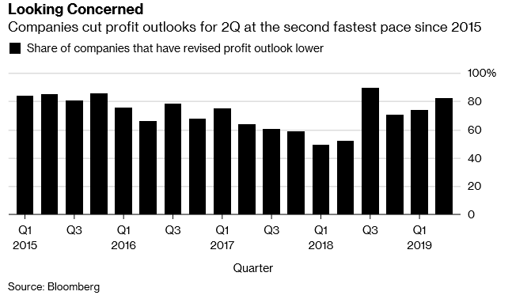
July 2019
Q2 Corporate Earnings
As we approach the Q2 earnings season in the US while equity valuations are reaching new highs, investors will be closely watching corporate earnings for signs that economic weakness and prolonged trade disputes are feeding into lower performance expectations for the rest of this year. After Q1 earnings showed full year estimates which were being held up by expectations for a second half recovery in corporate earnings, hopes for a recovery have been abating in recent weeks, resulting in an alarming amount of downward revisions of earnings expectations.
It’s not unusual for companies to cut profit expectations in the lead up to earnings season (to lower expectations for when they release earnings), however recently, more than 80% of S&P 500 companies that have revised profit estimates in the lead up to earnings reporting have slashed their forecasts. At the same time, equity markets continue to gain as investors overlook an increasingly poor earnings environment, placing higher weight on optimism over a US-China trade deal and monetary policy when they should be paying attention to earnings, which are what should really be driving stock prices.
According to Bloomberg data (as shown in the chart), 82% of the S&P 500 companies that have revised their profit outlook have cut guidance. Upon closer examination, this proportion is similar to that seen in Q3 last year, just before stock markets declined by around 20%.
Page 17

Slide 27
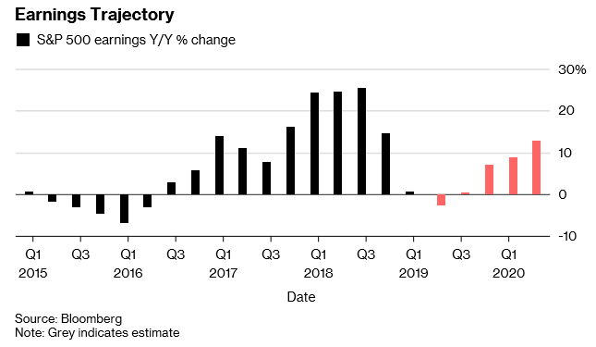
July 2019
Q2 Corporate Earnings (cont.)
Why are earnings expected to fall?
In recent months, there have been a number of headwinds facing corporate profitability, ranging from a strong dollar (a key issue for US-based international companies), higher input costs and uncertainty from the escalation of global trade tensions to lower demand following weaker global growth. These risks have not changed, with the recent trade truce providing little certainty of the future trade relationship between the US and China and with the effects of the trade war continuing to feed through into company financials.
A key reason behind the bulk reversion of corporate earnings in recent weeks is that although the economic data was poor throughout Q1, broad expectations within the market were that although the outlook for the first half of the year was poor, corporate earnings would recover in the second half. It has become clear that this is now not the case, with a resolution of the trade tensions still yet to come and with the global economy suffering as a result of increased tariffs and lower economic growth, evidenced by recent economic data and downgrades in growth expectations from the IMF and World Bank. According to Factset, the estimated earnings decline for the S&P 500 is -2.6%. The chart indicates the revised earnings trajectory from Bloomberg, showing a relatively flat Q3 followed by a small rebound in Q4.
Overall, investors will soon be forced to consider economic data and underlying company data with greater weighting in the coming weeks. It will become clear that equity valuations are inflated based on the underlying corporate earnings, and in our view this is likely to be a catalyst for a drop back in equity markets.
Page 18

Slide 28
Data Sets

Slide 29
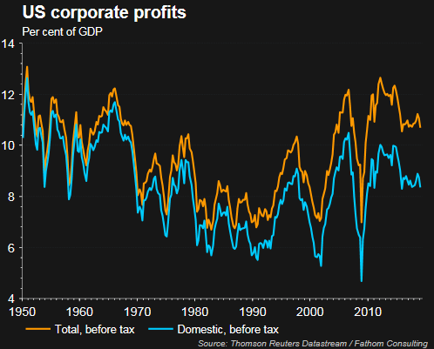
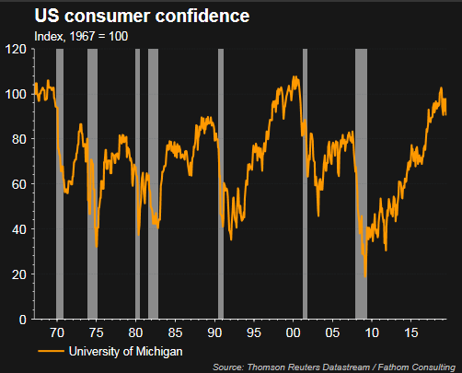
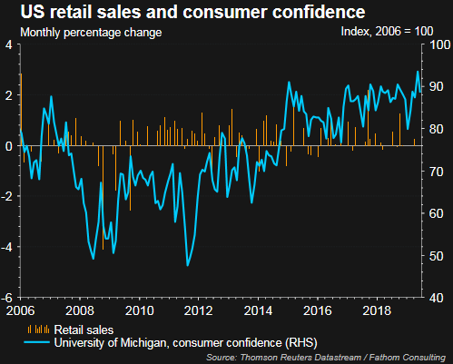
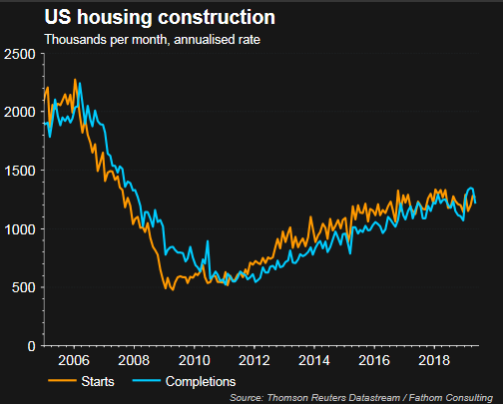
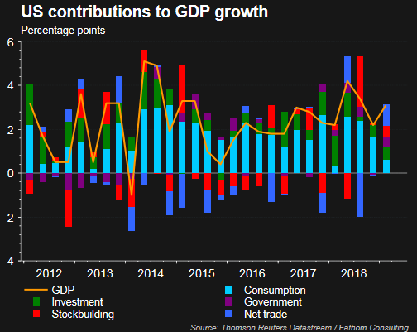
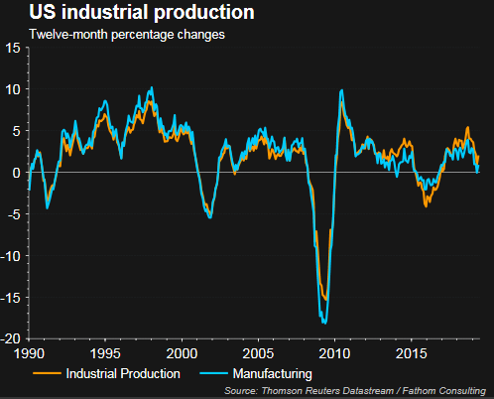
July 2019
Charts - US
Page 19

Slide 30
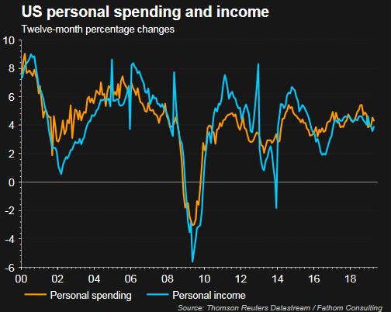
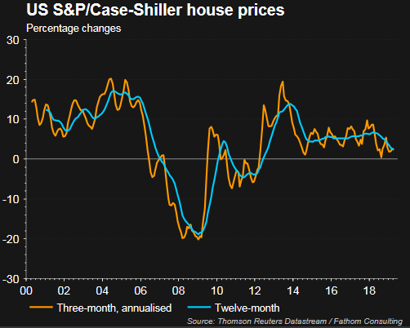
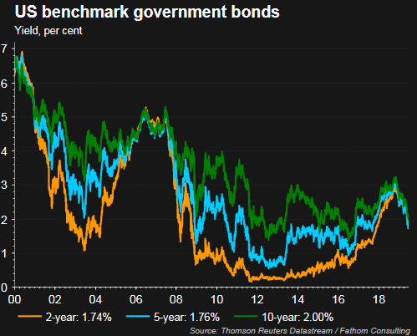
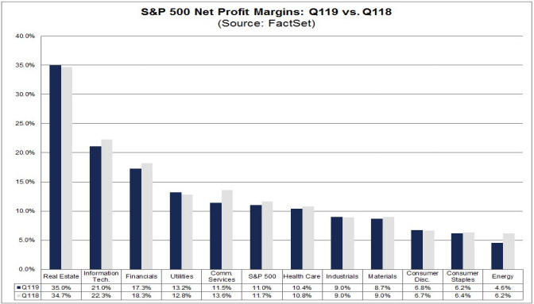
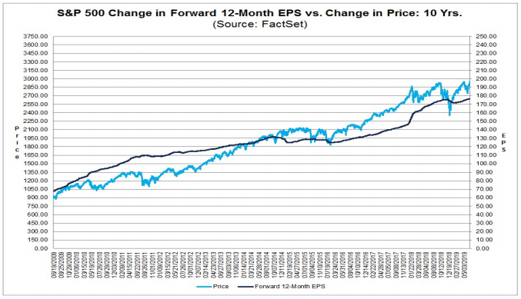
July 2019
Charts - US
Page 20

Slide 31
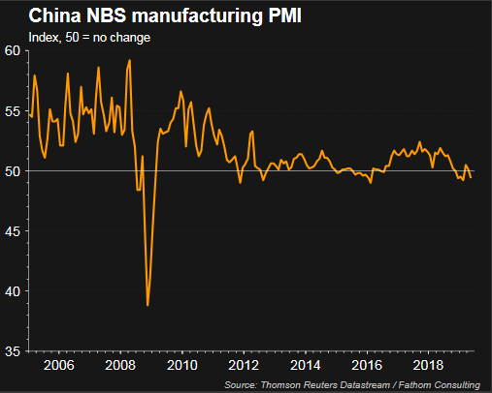
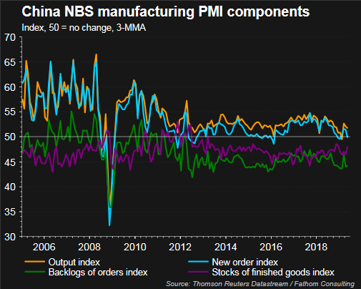
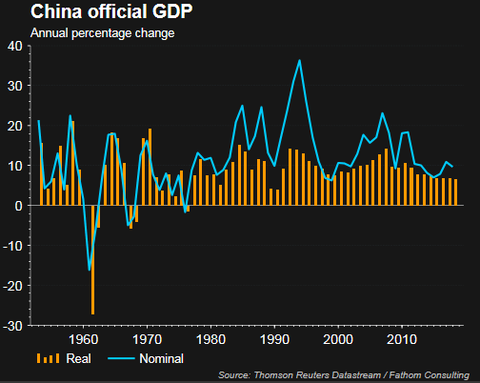
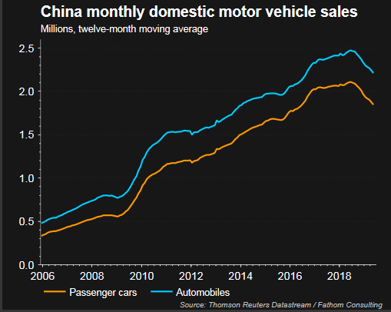
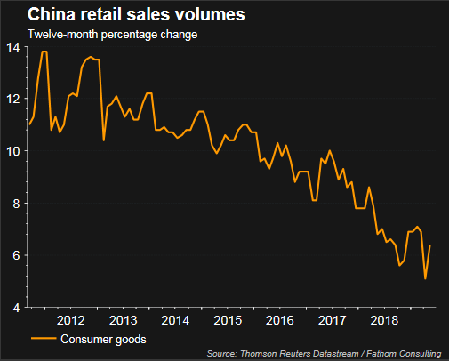
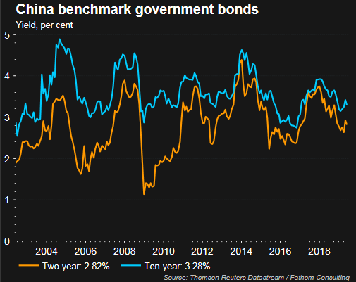
July 2019
Charts - China
Page 21

Slide 32
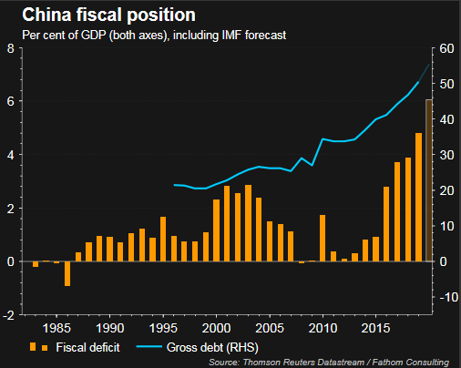
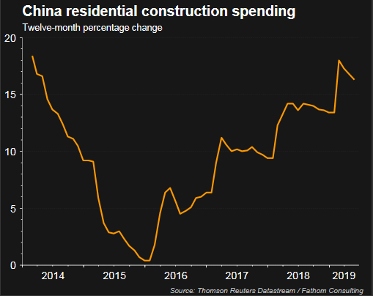
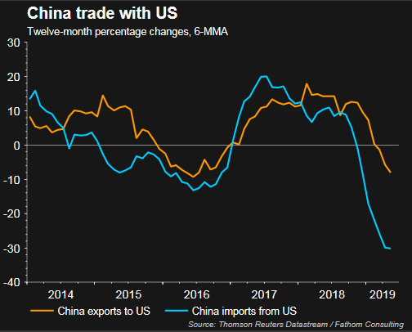
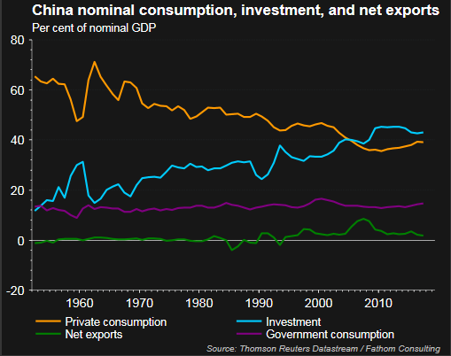
July 2019
Charts - China
Page 22

Slide 33
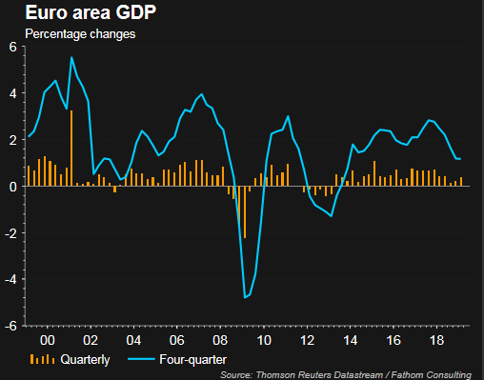
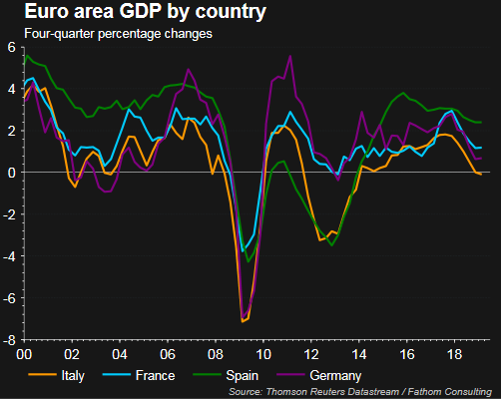
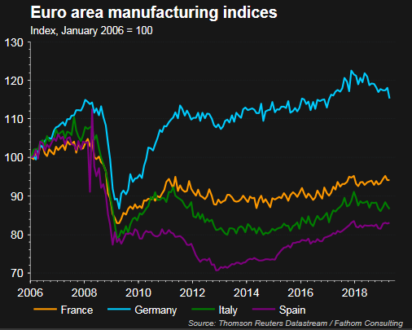
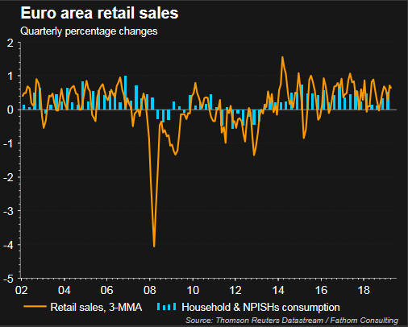
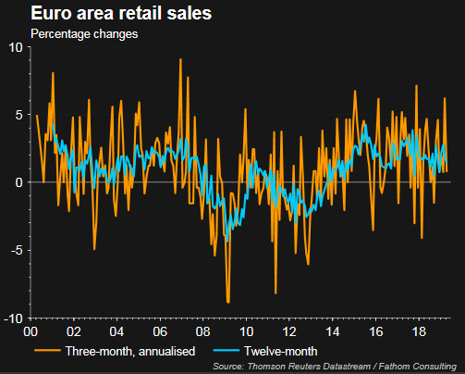
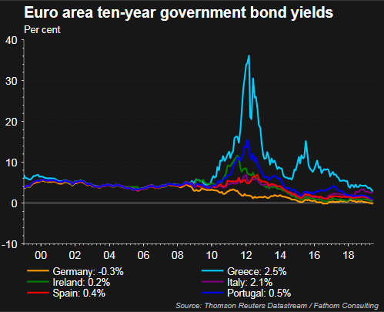
July 2019
Charts - Europe
Page 23

Slide 34
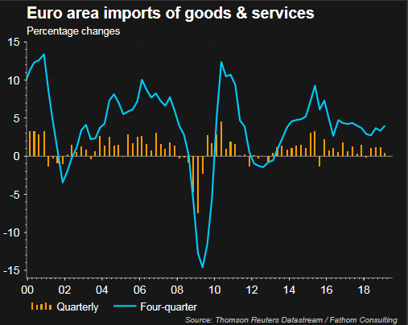
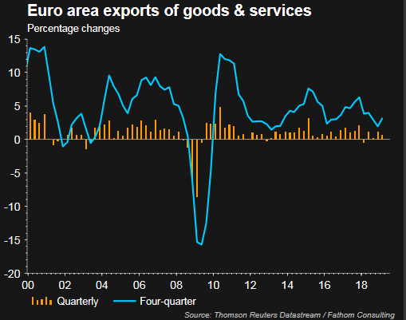
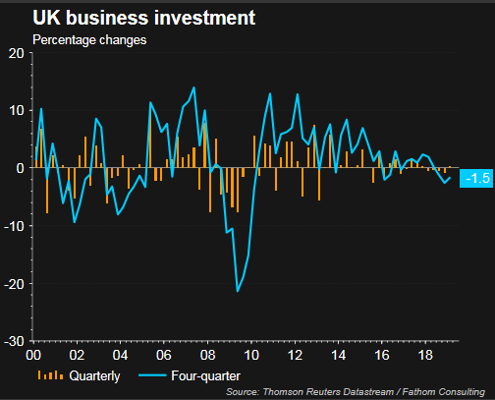
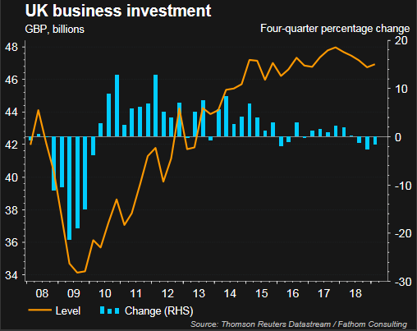
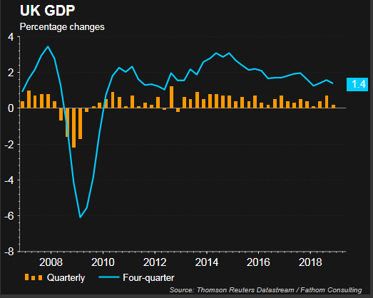
July 2019
Charts - Europe
Charts - UK
Page 24

Slide 35
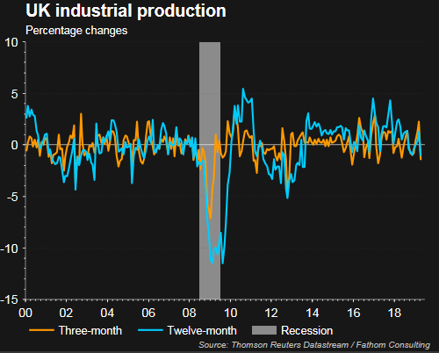
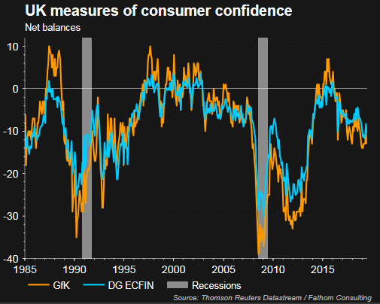
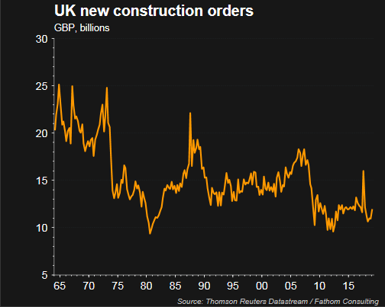
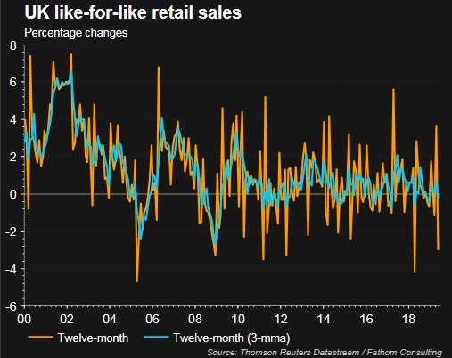
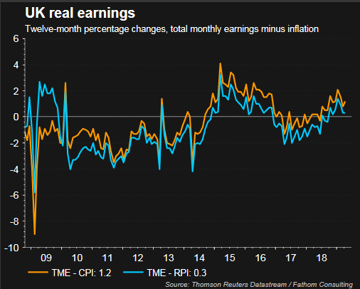
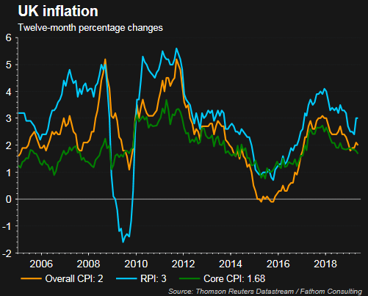
July 2019
Page 25

Slide 36





July 2019
Page 26

Slide 37
Legal Wordings
OCM Wealth Management Limited has expressed its own views and opinions in this document and these may change. The data contained in this document has been sourced by OCM Wealth Management Limited and it should not be further publicised or used.
Past performance cannot be used as a guide to future performance and the actual performance of an individual client’s portfolio may differ if on third party platforms due to different funds being used and being restricted in relation to asset allocation due to investment parameters being constrained.
The forecasts included in this presentation should not be relied upon, are not guaranteed and are provided only as “opinion” at the date of issue. Our forecasts are based on our own assumptions which may change. We accept no responsibility for any errors of fact or opinion and assume no obligation to provide you with any changes to our assumptions or forecasts. Forecasts and assumptions may be affected by external economic or other factors.
Issued in May 2019 by OCM Wealth Management Limited, 3 Bouverie Court, The Lakes, Northampton, NN4 7YD. Authorised and regulated by the Financial Conduct Authority, 418826.

